Slide 1
CS7/8745 : Machine Learning Instructor: Salim Sazzed Department of Computer Science University of Memphis

Slide 2
Decision Tree

Slide 3
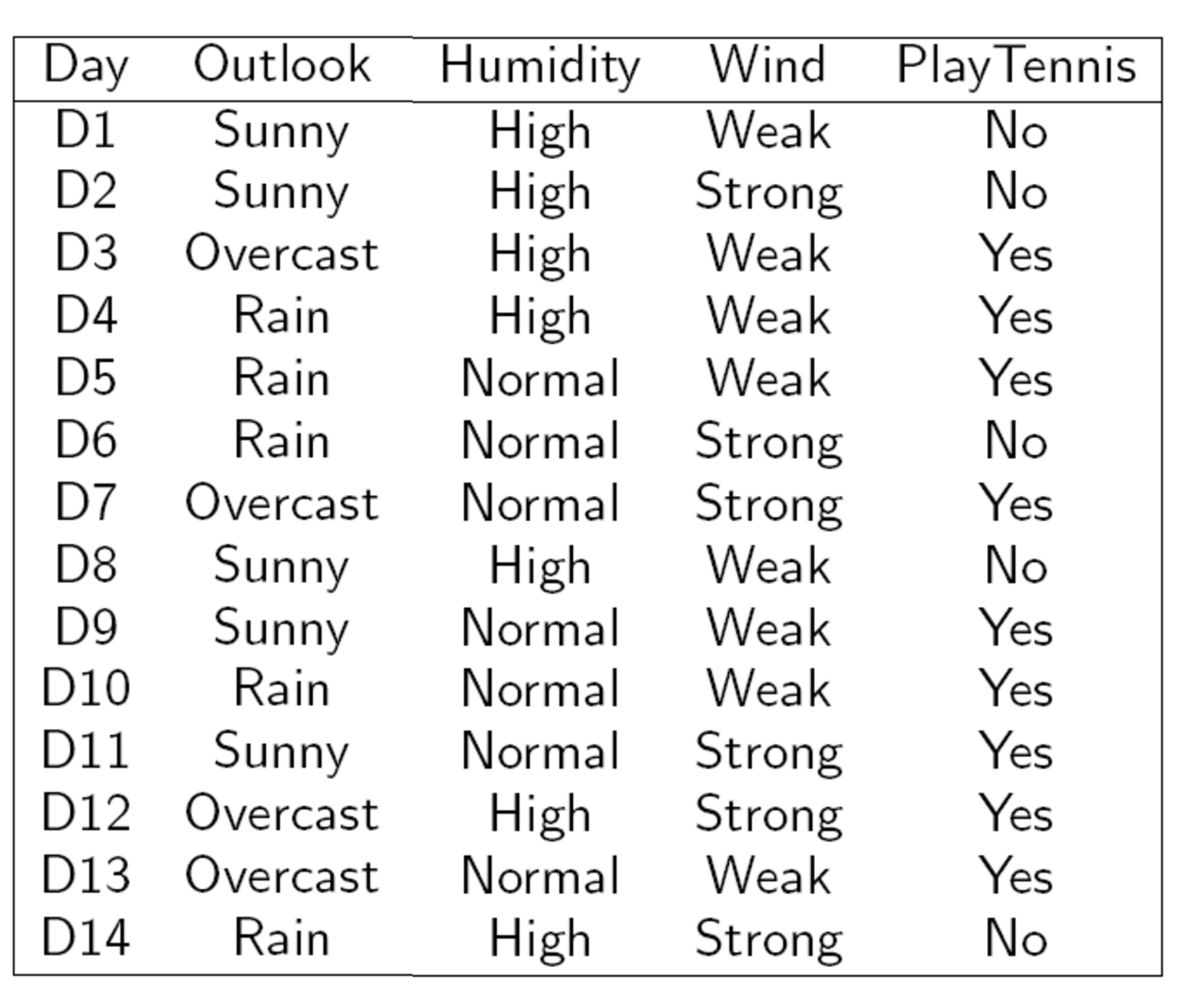
Target
14 samples
Each column represent one feature
Three Feature/Attributes

Slide 4
Entropy
In the context of Decision Trees, entropy is a measure of disorder or impurity in a node.
Thus, a node with more variable composition (multiple types) to have higher Entropy than a node which has only single type value.
The maximum level of entropy or disorder is given by 1 and minimum entropy is given by a value 0.

Slide 5
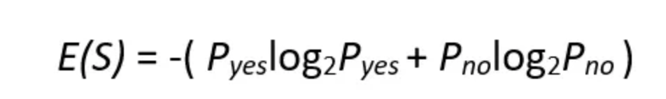
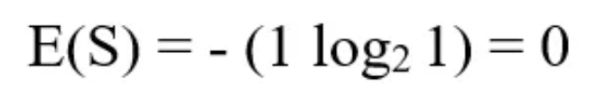
If we have a dataset of 10 observations belonging to two classes YES and NO. If 6 observations belong to the class, YES, and 4 observations belong to class NO, then entropy can be written as below.
P_{yes} is the probability of choosing YES and P_{no} is the probability of choosing a NO.
Here P_{yes} is 6/10 and P_{no} is 4/10.
If all the 10 observations belong to 1 class then entropy will be equal to zero. Which implies the node is a pure node.

Slide 6
If both classes YES and NO have an equal number of observations, then entropy will be equal to 1

Slide 7
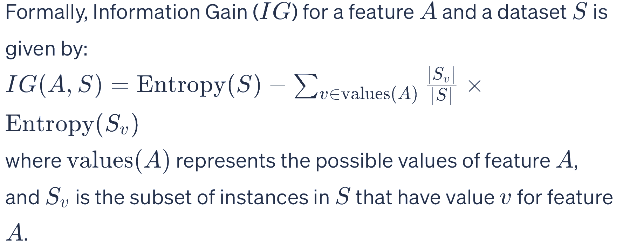
Information gain is used to decide on which feature to split on at each step in building the tree.
The Information Gain measures the expected reduction in entropy.
Entropy measures impurity in the data.
The feature which has minimum impurity (low entropy) will be considered as the root node.

Slide 8
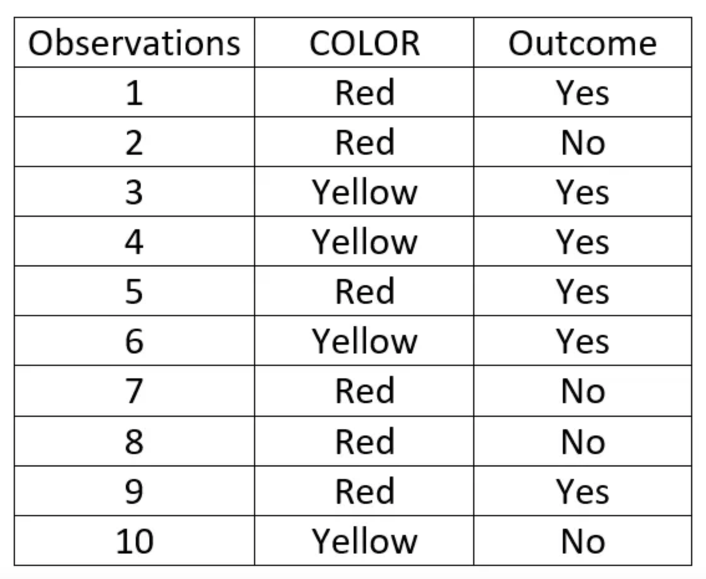
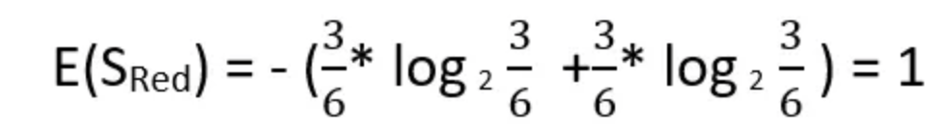
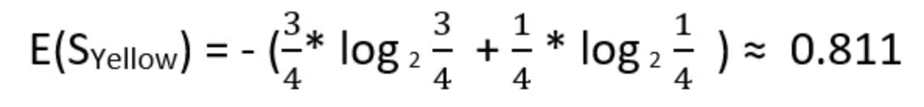
Red color has 3 Yes outcome and 3 No outcome
whereas yellow has 3 Yes outcome and 1 No outcome.

Slide 9
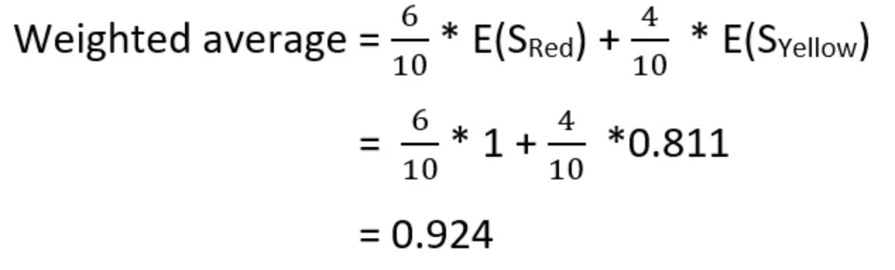
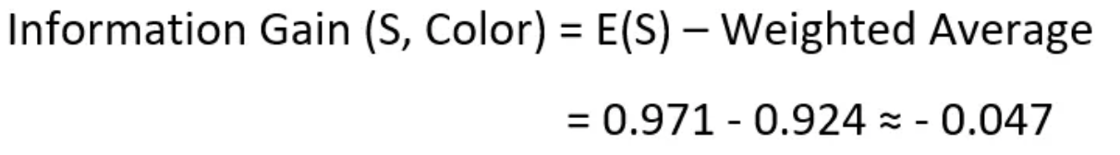
6 red color and 4 Yellow Color
For a dataset having many features, the information gain of each feature is calculated. The feature having maximum information gain will be the most important feature which will be the root node for the decision tree.

Slide 10
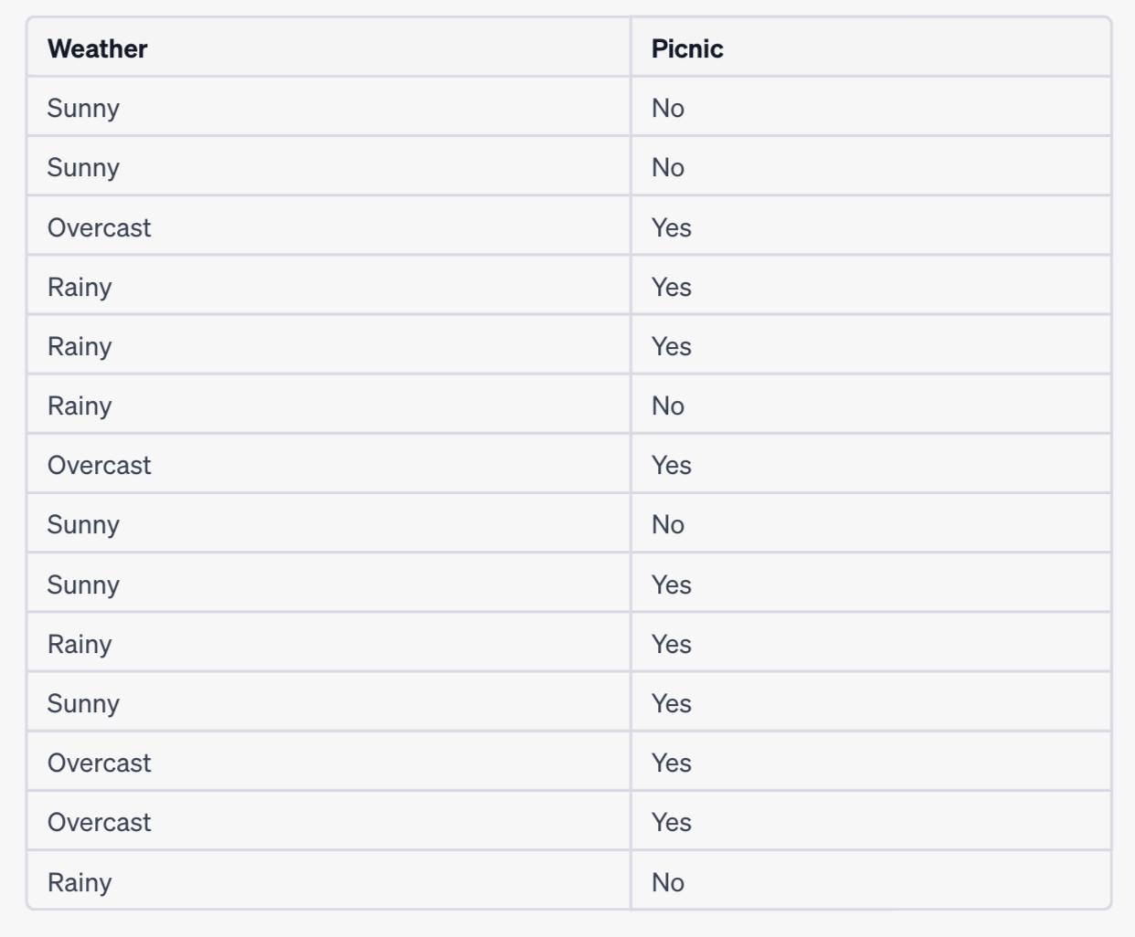



Sunny has ? outcome and ? outcome
$$E(S_{sunny})$$
Rainy has ? outcome and ? outcome
$$E(S_{rainly})$$
Overcast has ? outcome and ? outcome
$$E(S_{overcast})$$

Slide 11
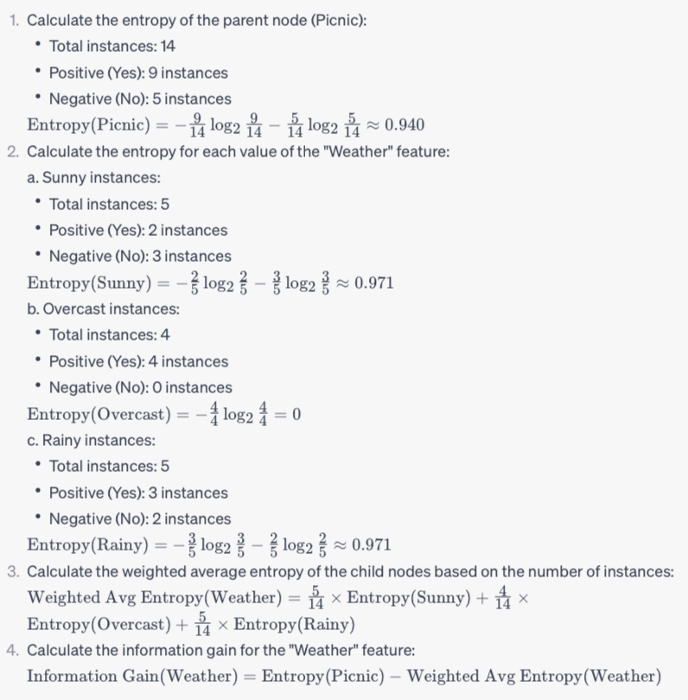

Slide 12
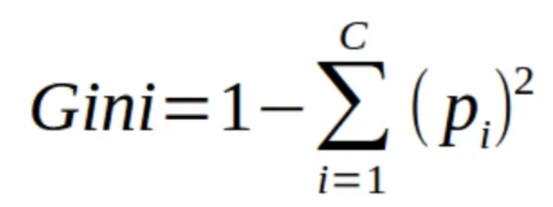
Gini Index
The tree chooses the feature that minimizes the Gini impurity index. The higher value of the Gini Index indicates the impurity is higher.

Slide 13
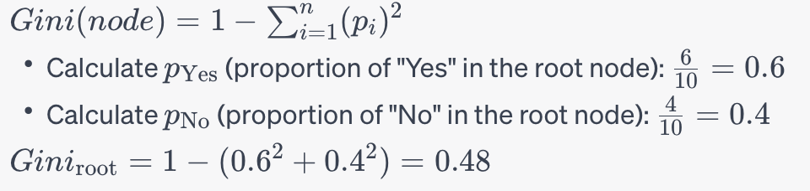
Customer | Income | Purchase
1 | High | Yes
2 | Low | No
3 | High | Yes
4 | Low | No
5 | Medium | Yes
6 | Low | No
7 | Low | Yes
8 | Medium | No
9 | Medium | Yes
10 | High | Yes
Calculate p_{Yes​} and p_{No}​ ”Low" subset:
3 No samples, 1 Yes samples, Compute Pyes and Pno
G(Income= Low) = 1 – ((3/4)² + (1/4)²) =
2. Calculate p_{Yes}​ and p_{No}​ ”Medium" subset
1 No samples, 2 Yes samples, Compute Pyes and Pno
G(Income= Medium) = 1 – ((1/3)² + (2/3)²) =
3. Calculate p_{Yes}​ and p_{No}. ​”High" subset
3 Yes samples, Compute Pyes and Pno
G(Income= High) = 1 – (1² + 0²) = 0
https://towardsdatascience.com/decision-trees-explained-entropy-information-gain-gini-index-ccp-pruning-4d78070db36c

Slide 14
Gini Index vs Information Gain
Depending on which impurity measurement is used, tree classification results can vary. This can make small (or sometimes large) impact on your model. There seems to be no one preferred approach by different Decision Tree algorithms. For example, CART uses Gini; ID3 and C4.5 use Entropy.
The Gini index has a maximum impurity is 0.5 and maximum purity is 0, whereas Entropy has a maximum impurity of 1 and maximum purity is 0

Slide 15
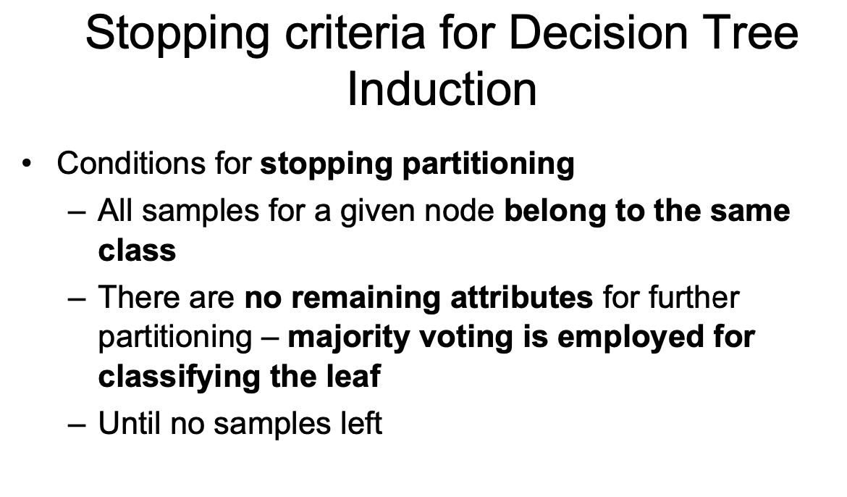

Slide 16
Overfitting:
Classifiers perform well on the training data but poorly on unseen data.
ML Model learns the statistical noise in the training data, which results in poor performance when the model is evaluated on new data ( test data, unseen data).
Overfitting: Fitting the data more than is warranted
Features are noisy / uncorrelated to concept
Modeling process very sensitive (powerful)
Too much search

Slide 17
Overfitting and Decision Trees
Overfitting can be a big challenge with Decision Trees.
Often the leaf node may just have one or two instances.
This will clearly lead to a complex tree structure which may not generalize well to a test scenario. This is because each leaf will represent a very specific set of attribute combinations that are seen in the training data, and the tree will not be able to classify attribute combinations not seen in the training data.
There are several ways we can prevent the decision tree from becoming

Slide 18
Variance
Variance refers to the model's sensitivity to small fluctuations or noise in the training data. It measures how much the model's predictions would vary if trained on a different subset of the data.
High variance indicates that the model is too complex and has effectively memorized the training data rather than generalizing from it. This often leads to overfitting, where the model performs well on the training data but poorly on unseen data because it has not learned the underlying patterns but has instead fit the noise in the data.
Examples of high-variance models include too deep decision tree

Slide 19
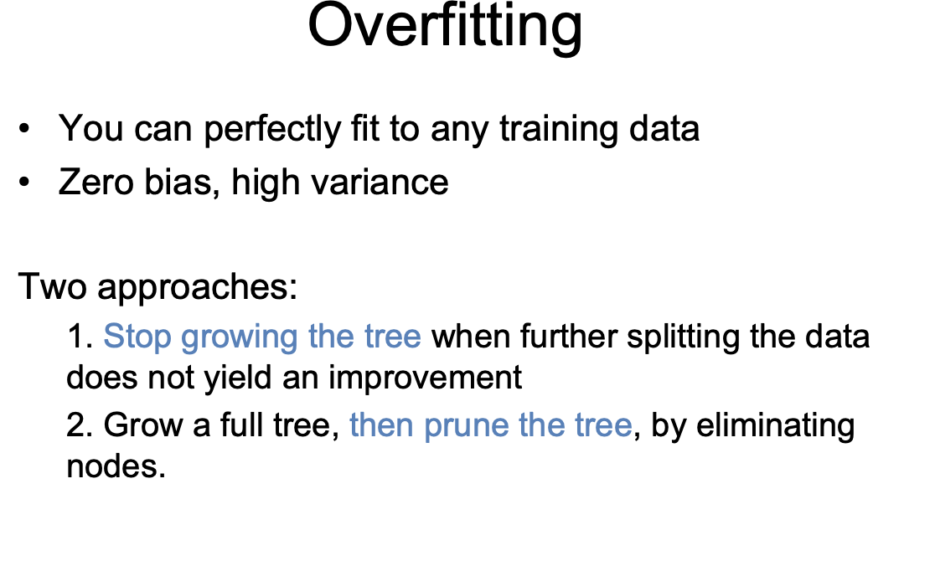

Slide 20
Pruning
When the tree is fully grown up, it is liking to overfit data due to noise or outliers which can lead to anomalies in decision trees. Which in turn leads to poor accuracy. This can be handled by using pruning.
Pruning is the process of removing redundant comparisons or removing subtrees.
Pruning reduces unnecessary comparisons and achieves better performance.
Pruned trees are less complex, smaller, and easy to understand.
There are two approaches for pruning, the pre-pruning approach in which splitting or partition of the tree is halted at a particular node.
whereas in post-pruning approach removes subtree from the full tree. A subtree is pruned at a node. It is done by removing the branches at a node and replacing it with a leaf node.

Slide 21
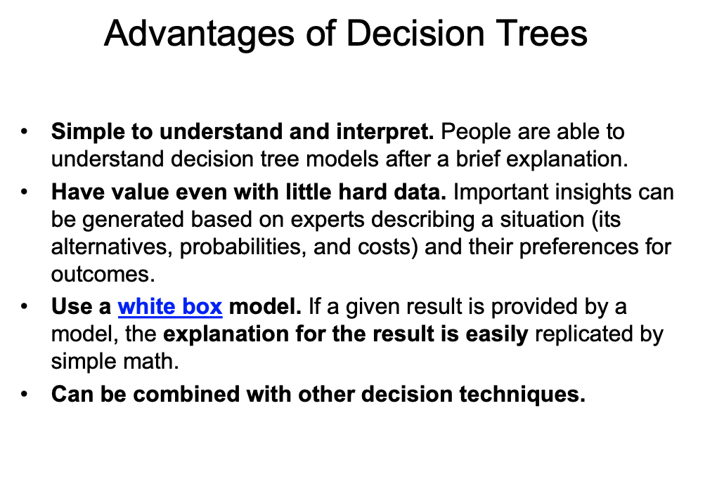

Slide 22
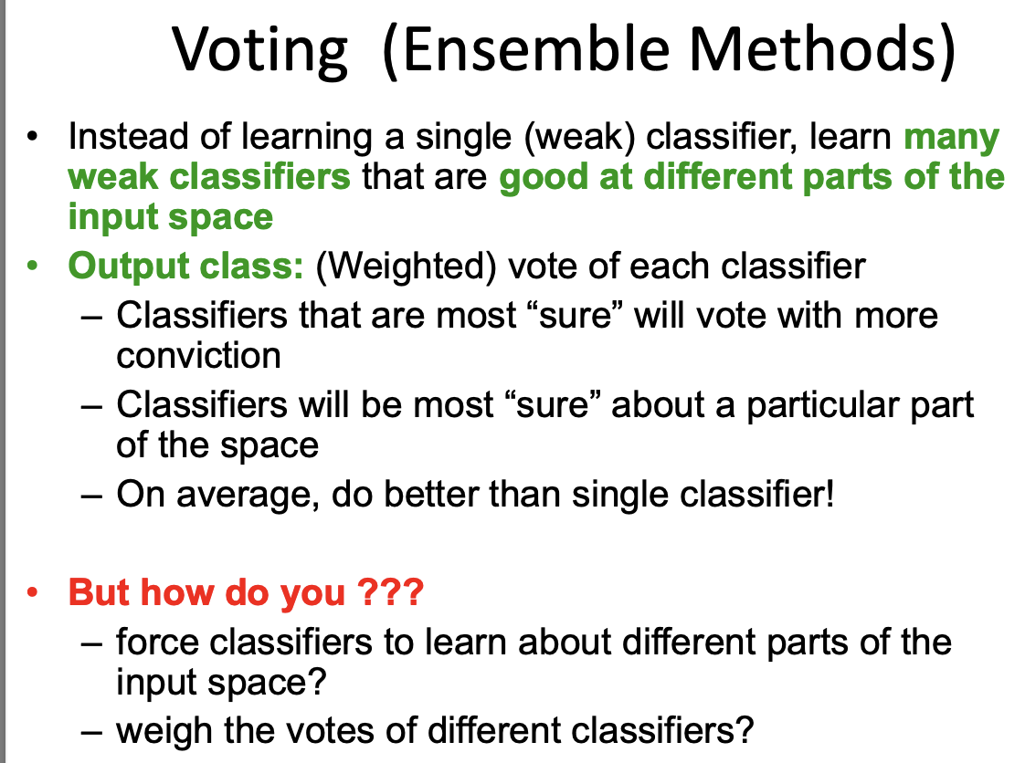

Slide 23
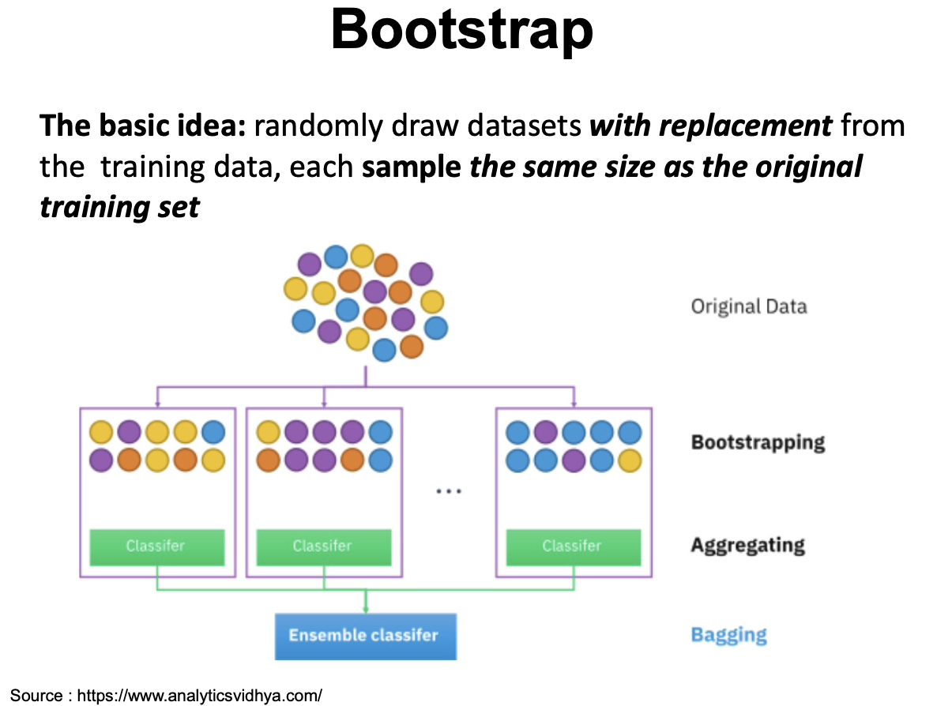
Bagging, or Bootstrap Aggregating, is an ensemble machine learning technique .

Slide 24
Bootstrap Sampling:. For each subset, data points are randomly selected with replacement from the original training dataset. This means that some data points may appear multiple times in a subset, while others may not appear at all.
Model Training: A base learning algorithm, often a decision tree is trained on each of these bootstrap samples. Each subset is used to train a separate base model.
3. Voting or Averaging: When making predictions, the ensemble model (the bagged model) combines the predictions from each base model.
For classification tasks, a majority vote is often used. Each base model predicts a class label, and the class with the most votes is the final prediction.
For regression tasks, the predictions from each base model are averaged.

Slide 25
Key benefits of bagging
Reduced Variance: Because each base model is trained on a slightly different subset of the data, it introduces diversity into the ensemble. This diversity helps reduce the variance in the predictions and makes the model less prone to overfitting.
Improved Generalization: Bagging typically leads to improved generalization performance, making it a useful technique for improving the accuracy of machine learning models.
Robustness: Bagging can increase the model's robustness by reducing the impact of outliers or noisy data points in the training set.

Slide 26
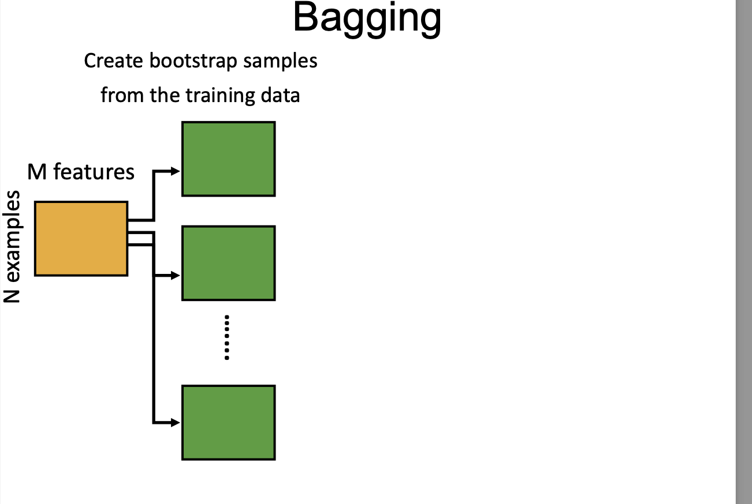
Or Bootstrap Aggregating

Slide 27
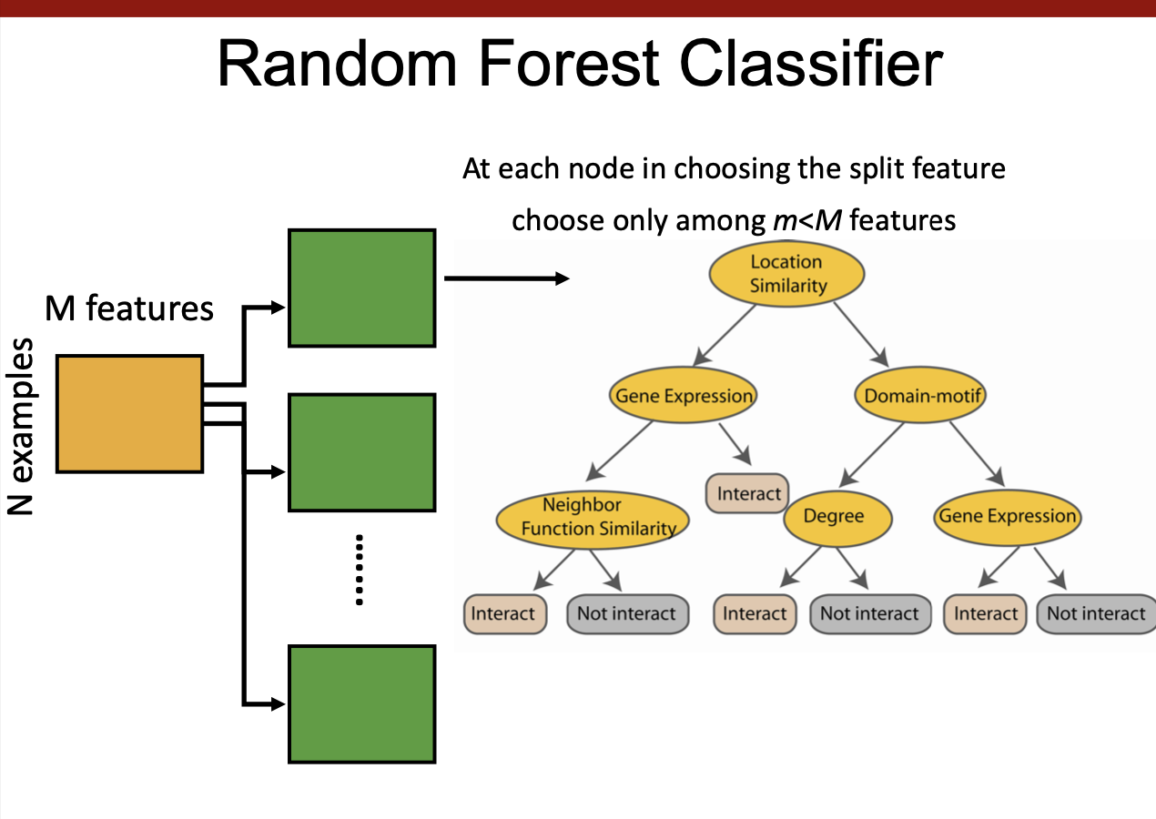

Slide 28
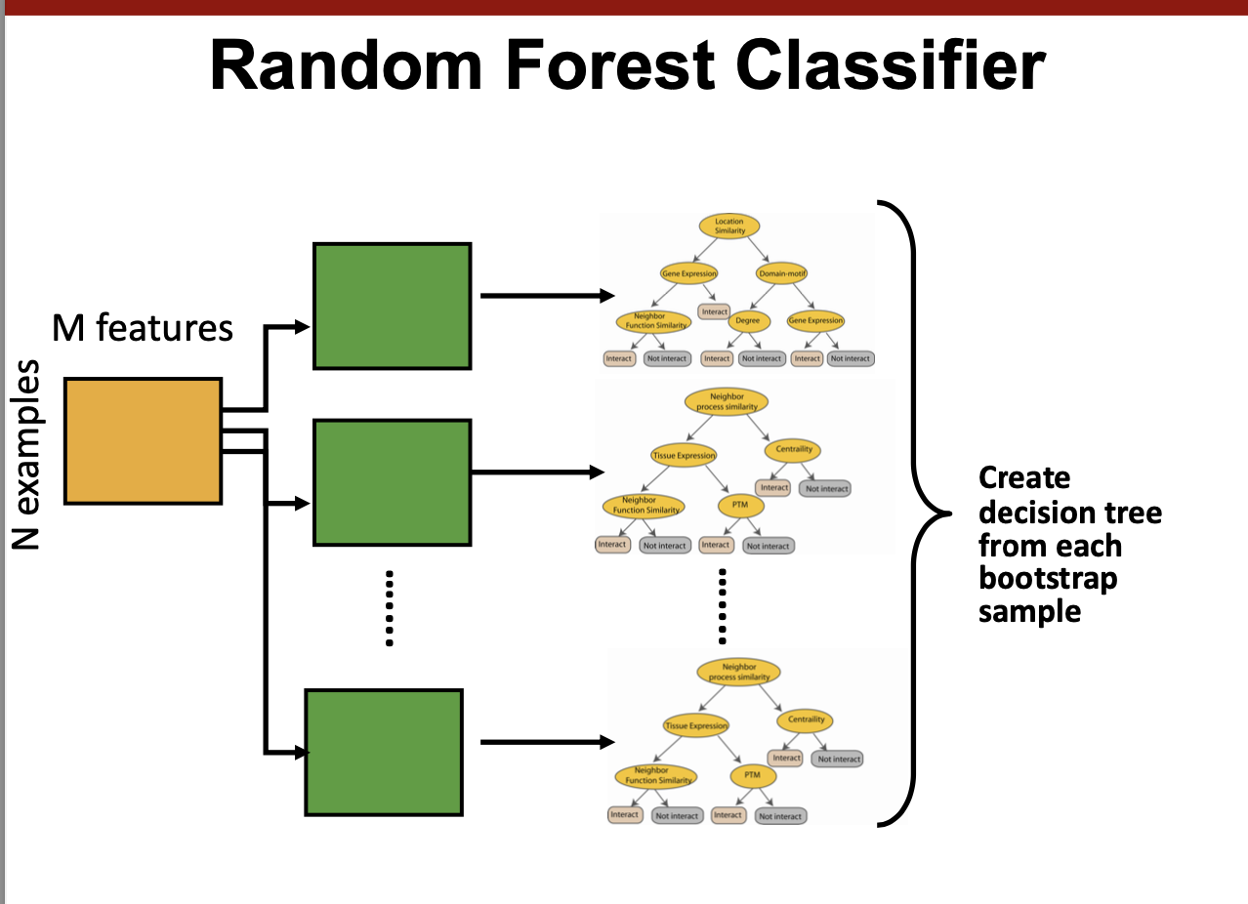

Slide 29
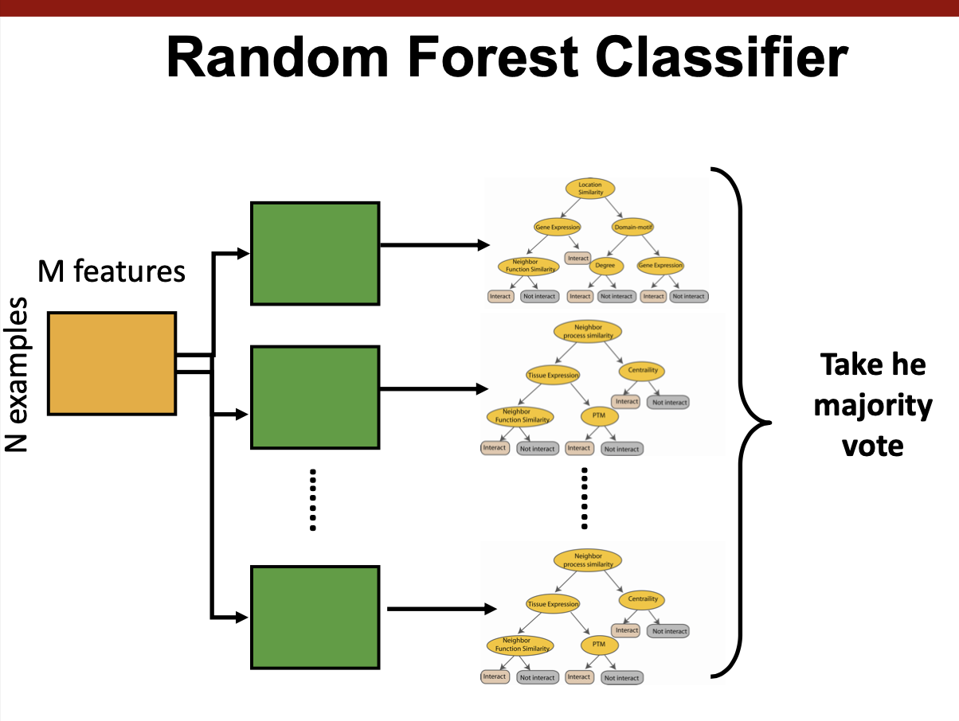
https://www.youtube.com/watch?v=J4Wdy0Wc_xQ

Slide 30
